Slide 1
Let’s take a look at…
frontend
What is a Frontend?
What is a Frontend Developer?
What do we expect from a Webapp?
How do we get there?

Slide 2
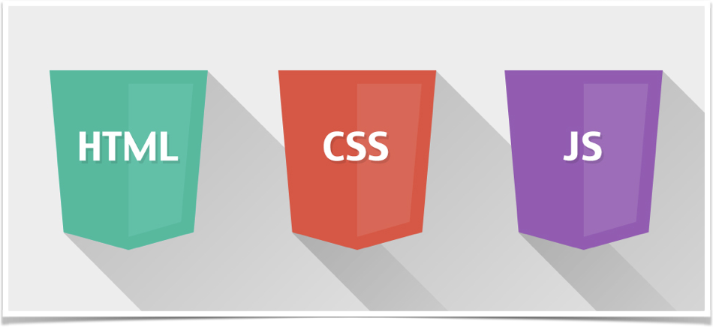
This is just the start…
What is Frontend?
There’s frameworks, languages, browser compatibility, responsive design, mobile, endless libraries and more…

Slide 3
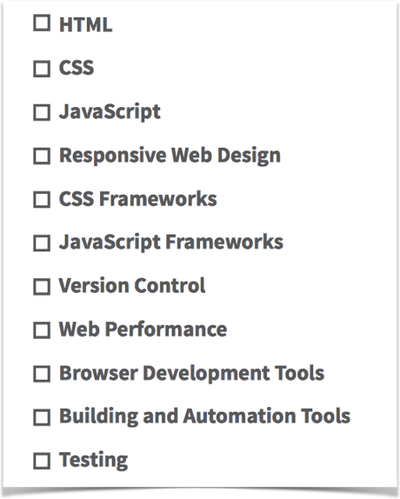
What is a Frontend Developer?
Check out the list on the right…
A Frontend Developer must have a good level of knowledge in all these subjects
And that’s just scratching the surface
Every subject in the list is a whole world
The list grows every day
The Web gets new features at a very fast pace

Slide 4

That was a real bad example for a slide, right?
too busy, too many points…
That’s what a Frontend Developer needs to know,
Everything!

Slide 5
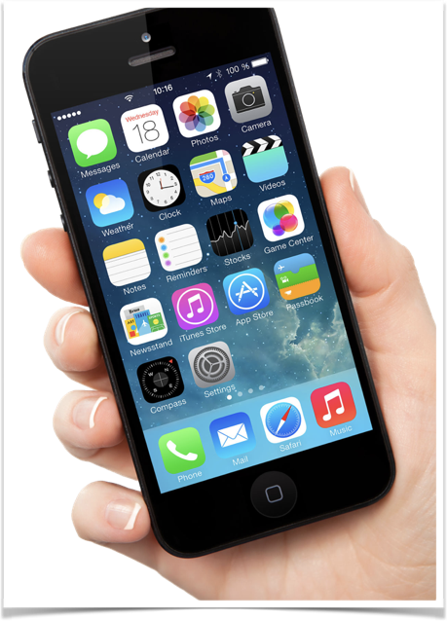
Same as we expect any other thing we use…
What do we expect from our Webapp?
Fast
Reliable
Bugless
Gets new features fast
Looks good
Attention to details
Customizable

Slide 6


So, how do we get there?!
UI library
User Experience
Tools

Slide 7

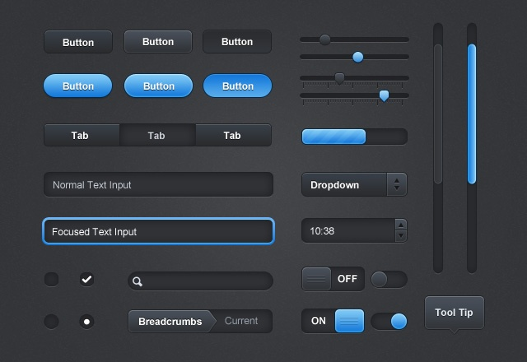
Choosing a robust UI library that is also light and allows maximum control
1.
A very basic, non intrusive library that allows the developer maximum flexibility.

Slide 8
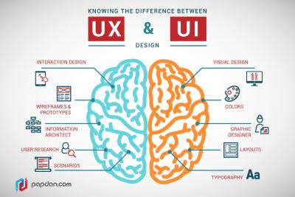
Investing in UX to create a comfortable and flowing UI
2.
Because details are very important and an eye appealing and flowing UI will bring in more customers.

Slide 9


Simplifying the build process using the right tools
3.
Having the right tools will contribute to a faster development process and a better quality product.

Slide 10
“Check out this example project…”
github.com/zerkotin/kanbanboard/wiki

